Slide 1
PLECS TI C2000 Target Installation
Tianxiao Chen

Slide 2
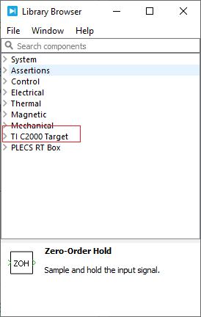
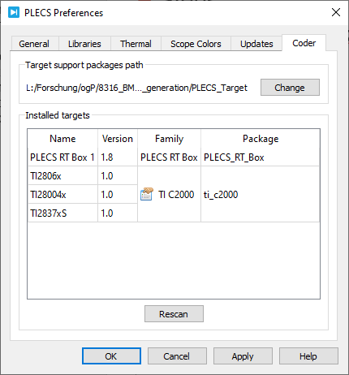
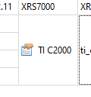
Installation
Tutorial video:
https://www.plexim.com/support/videos/coder-c2000-getting-started
Create a new folder at …/PLECS/Target
Download C2000 package and extract to Target folder:
https://www.plexim.com/de/download/tsp_c2000
Include the Target at PLECS preference
Install other tools
Install C2000 code generation tools (v1.9):
http://www.ti.com/tool/c2000-cgt
Install TI Uniflash (v5.2.0 or later):
http://www.ti.com/tool/UNIFLASH
Or through software center
Edit target family settings at PLECS preference
Codegen directory
Uniflash directory
Click here
And make sure the icon look like this at the end

